Slide 1
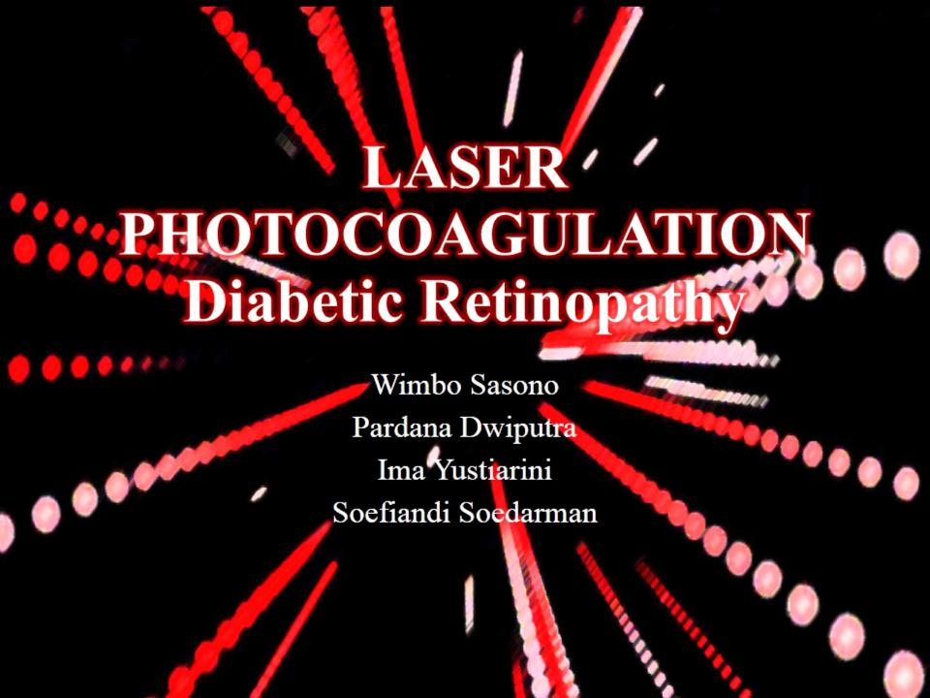
LASER PHOTOCOAGULATION
Diabetic Retinopathy

Slide 2
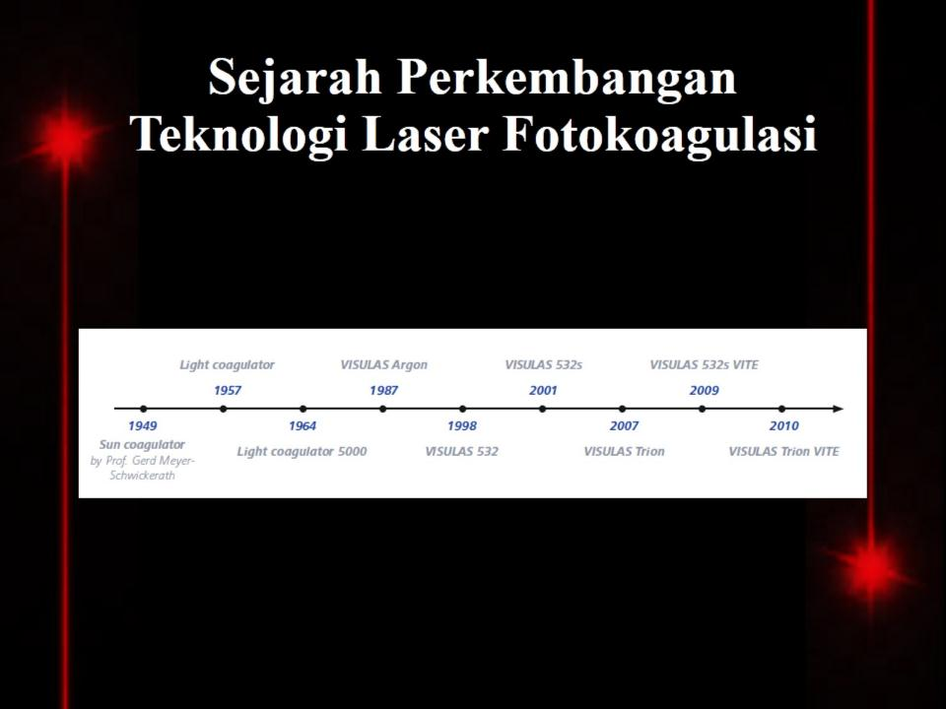
Sejarah Perkembangan
Teknologi Laser Fotokoagulasi

Slide 3
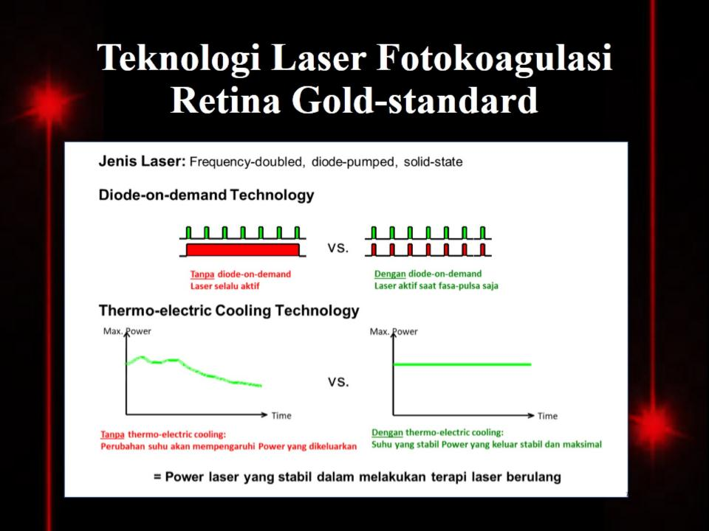
Teknologi Laser Fotokoagulasi
Retina Gold-standard

Slide 4
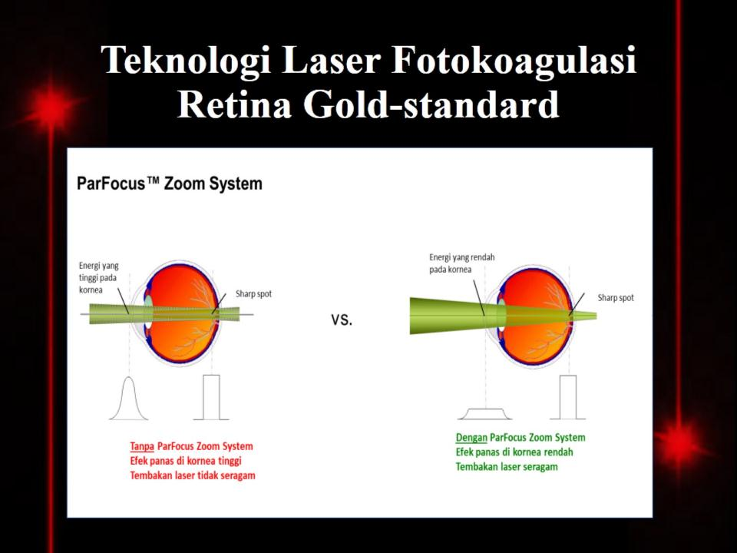
Teknologi Laser Fotokoagulasi
Retina Gold-standard

Slide 5
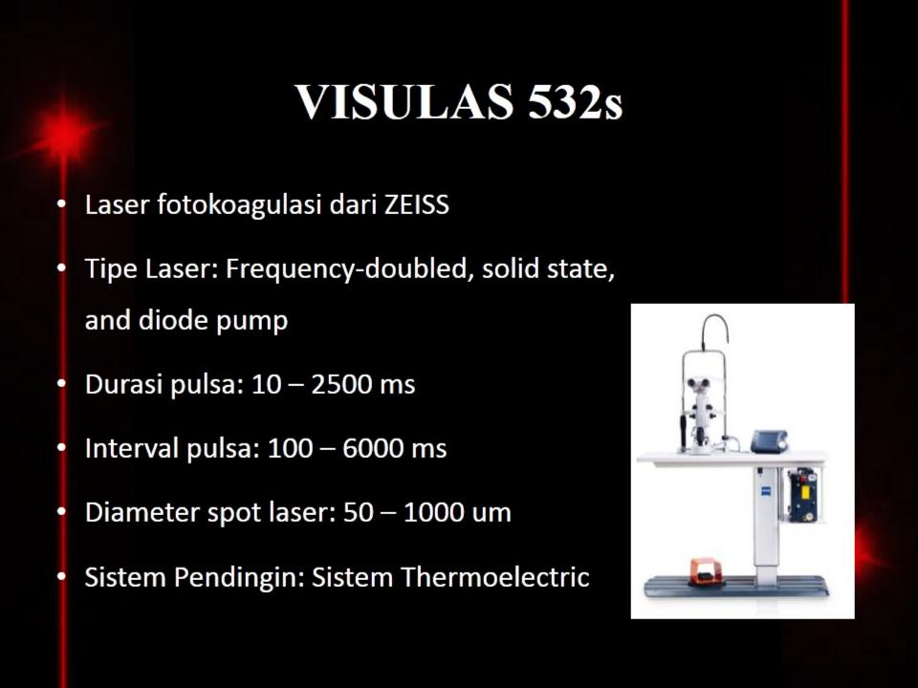
VISULAS 532s

Slide 6
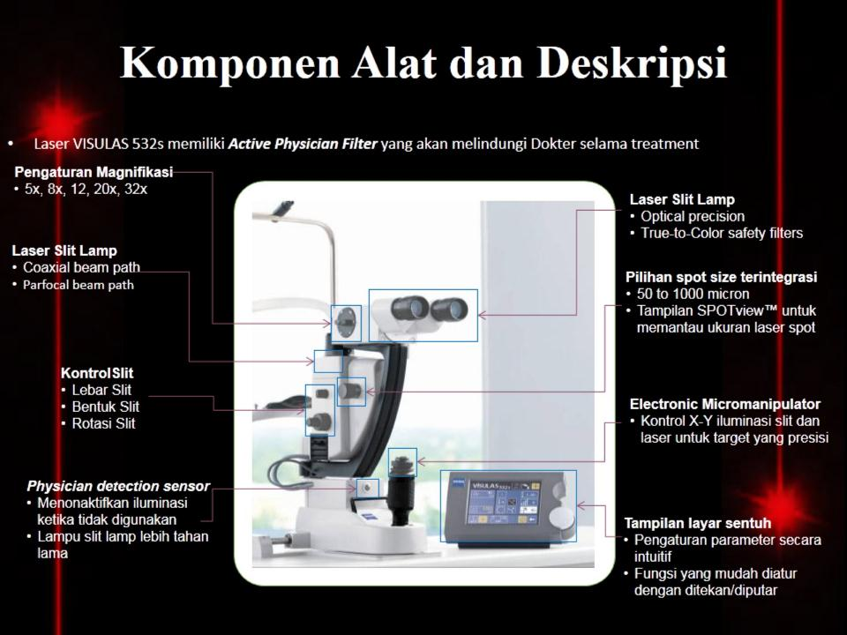
Komponen Alat dan Deskripsi

Slide 7
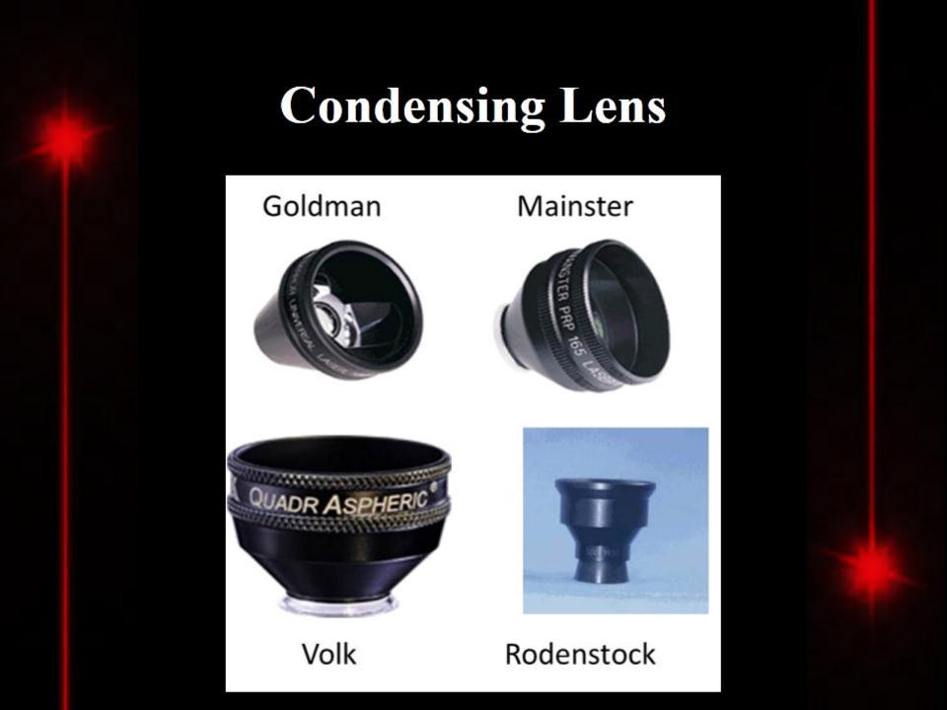
Condensing Lens

Slide 8
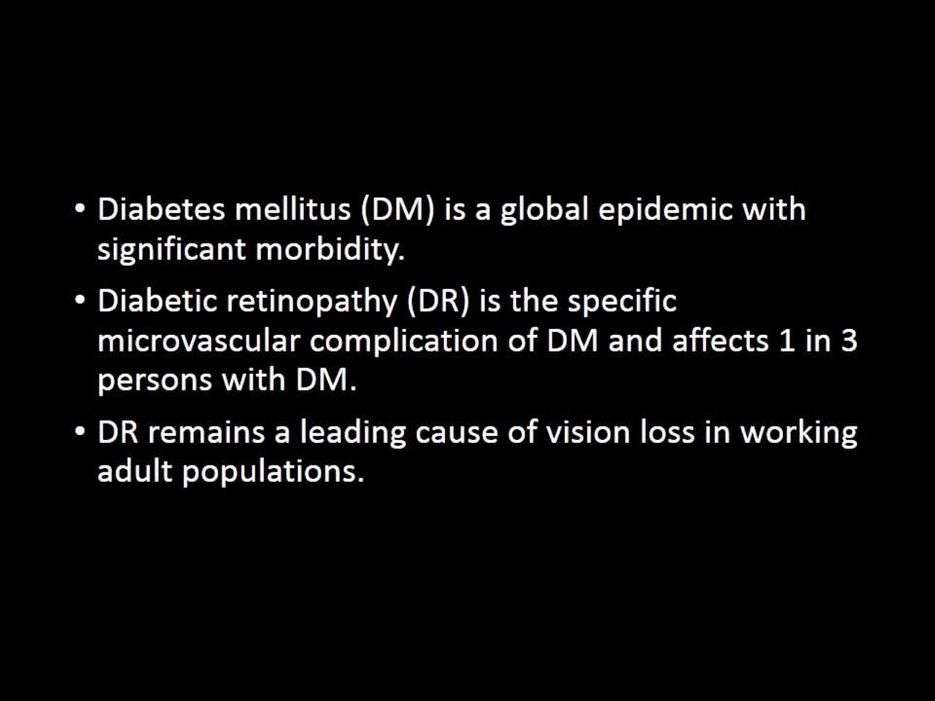
Introduction

Slide 9
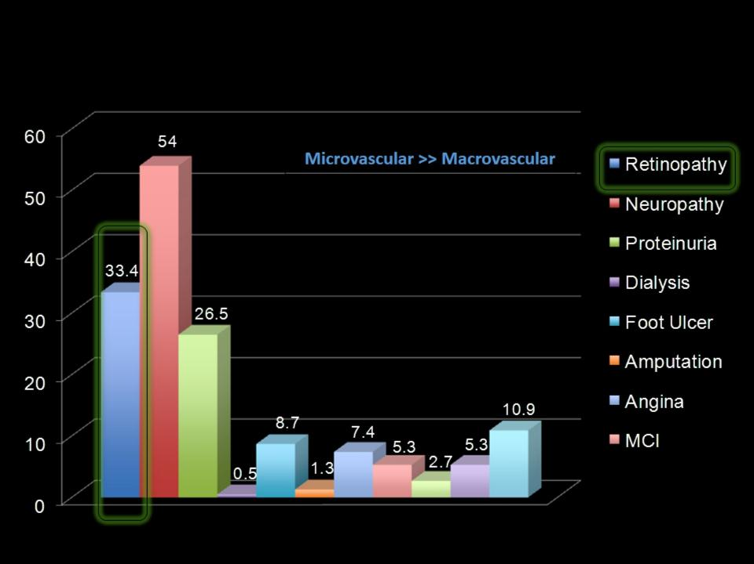
Indonesia: Epidemiology of Diabetic Complications

Slide 10
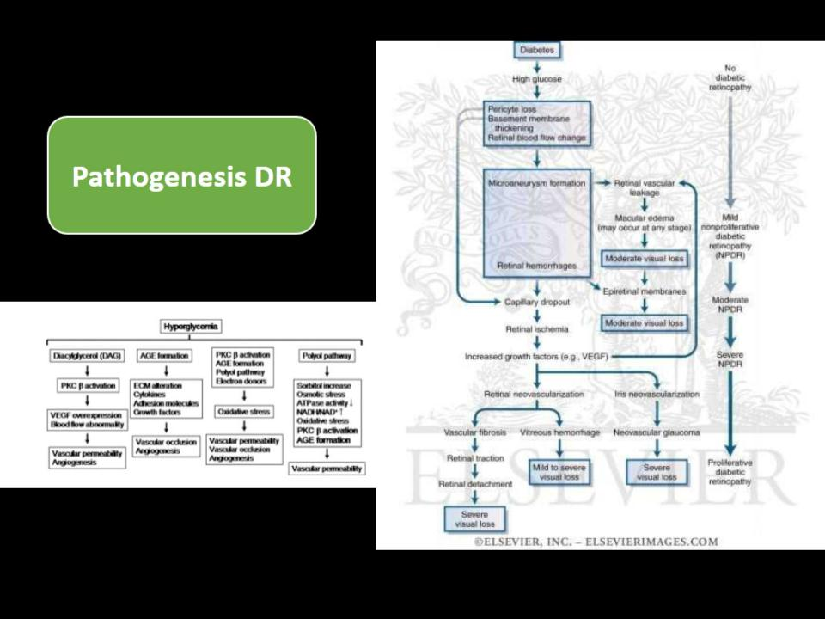

Slide 11
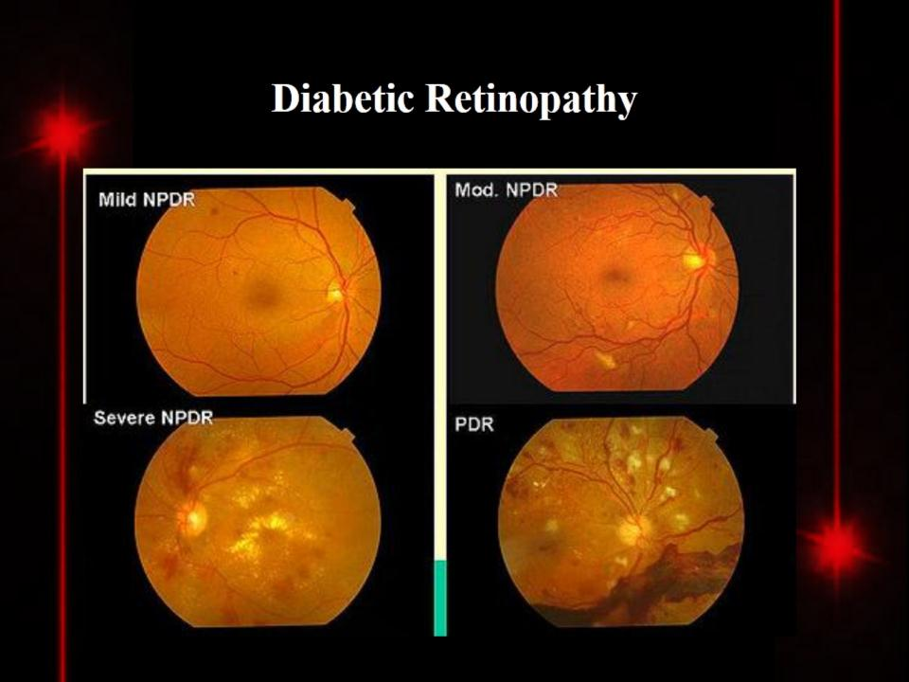
Diabetic Retinopathy

Slide 12
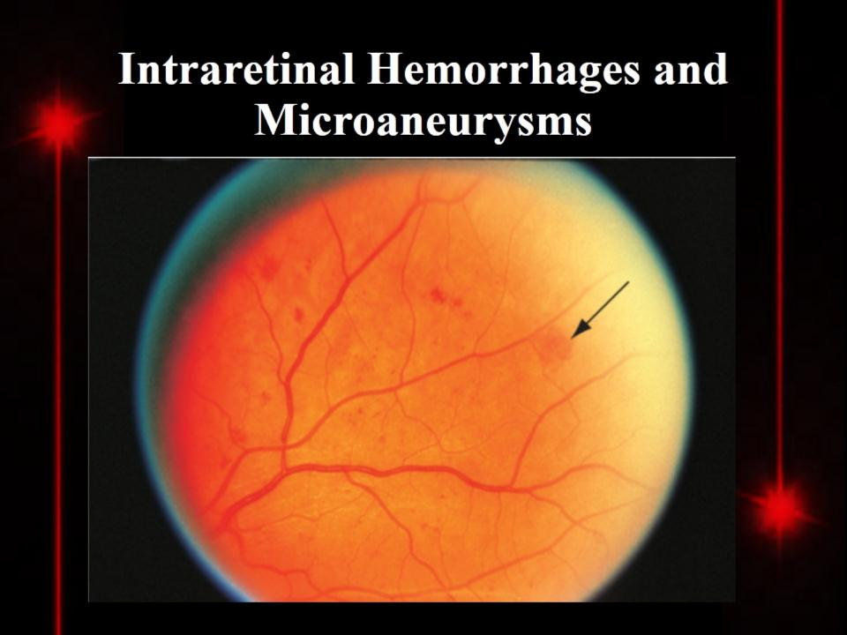
Intraretinal Hemorrhages and Microaneurysms

Slide 13
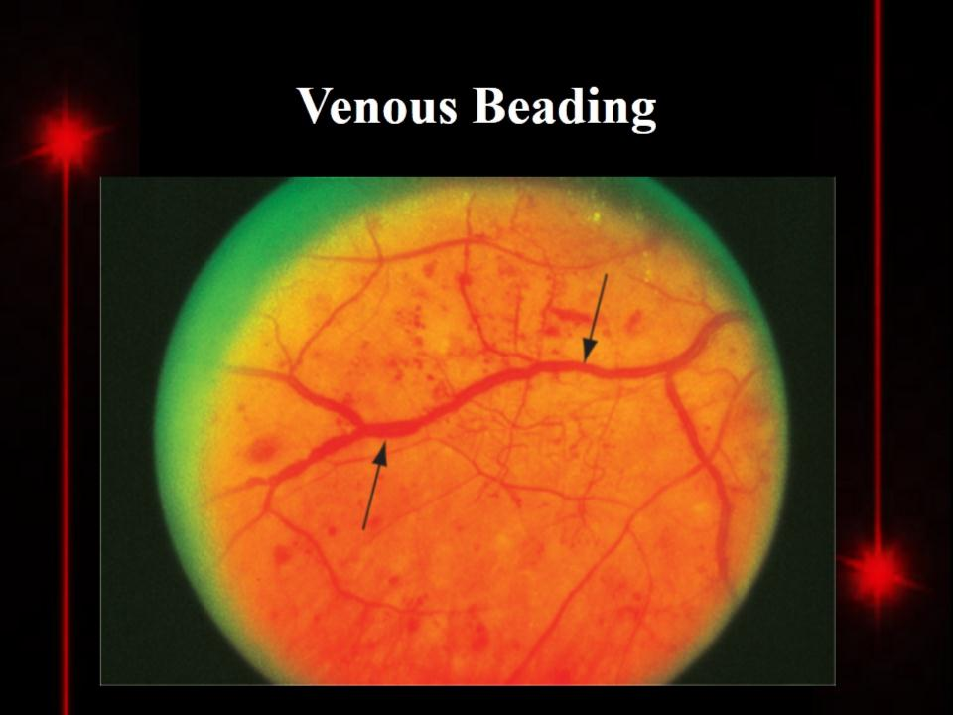
Venous Beading

Slide 14
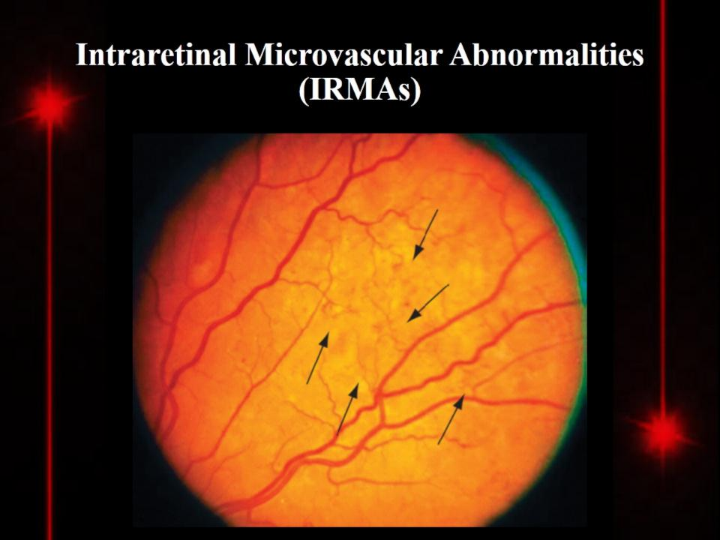
Intraretinal Microvascular Abnormalities (IRMAs)

Slide 15
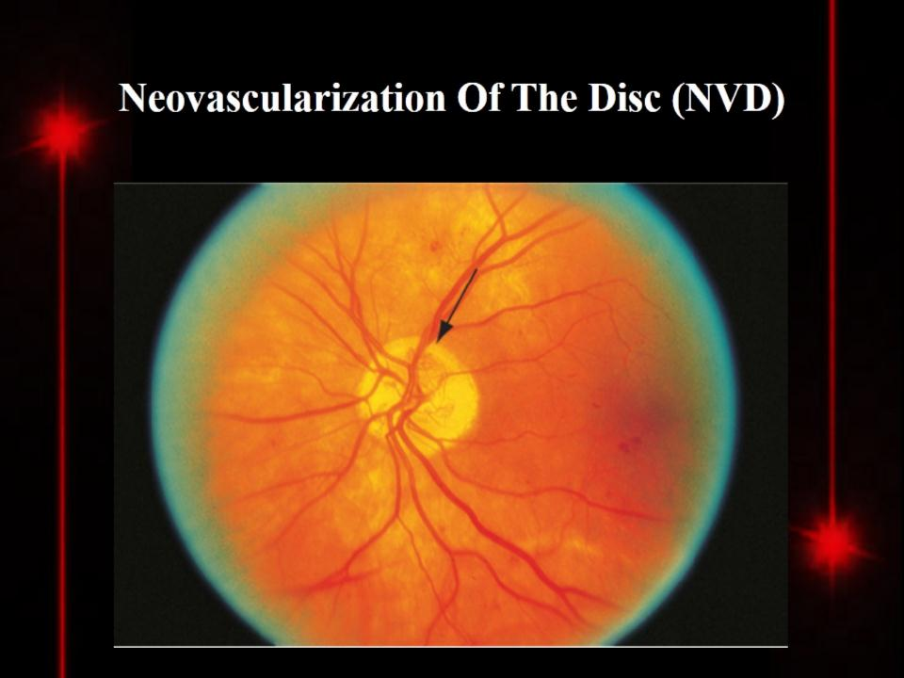
Neovascularization Of The Disc (NVD)

Slide 16
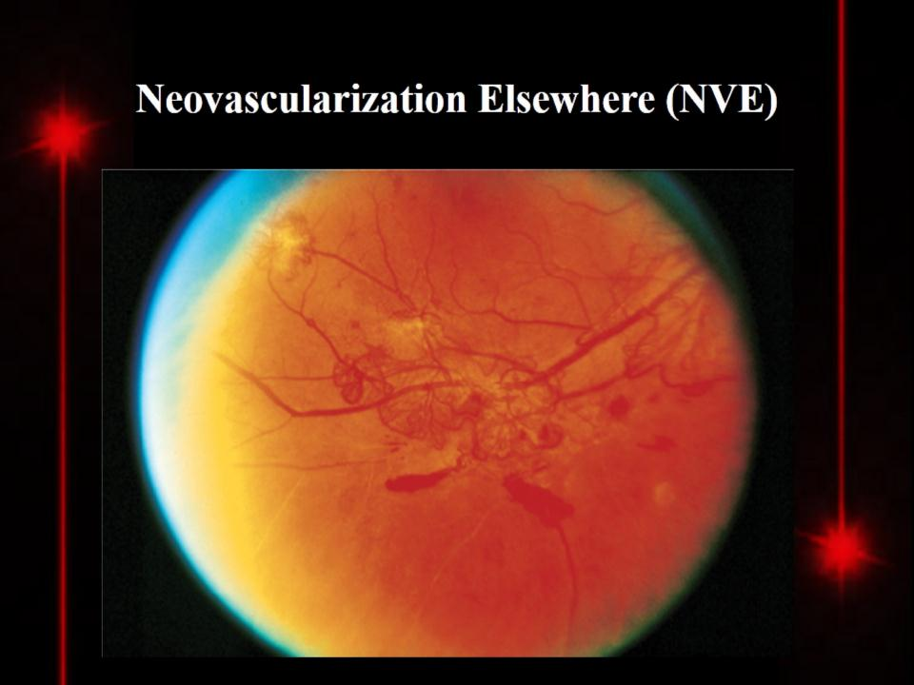
Neovascularization Elsewhere (NVE)

Slide 17
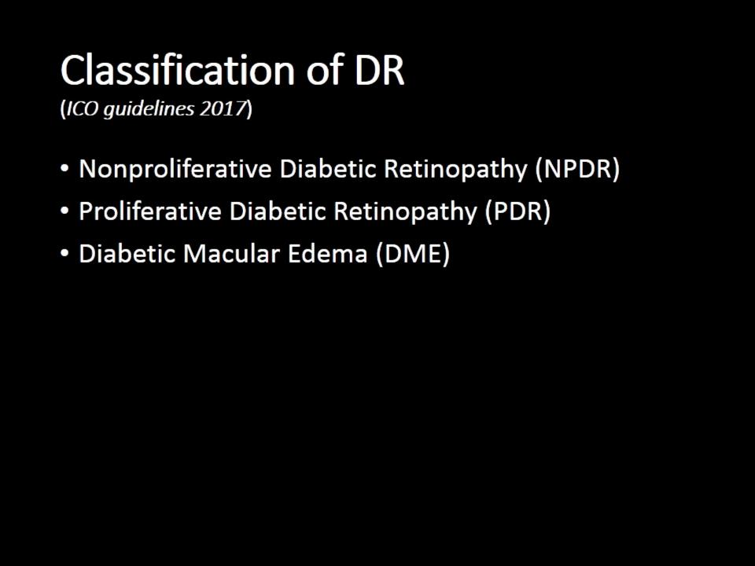
Classification of DR
(ICO guidelines 2017)

Slide 18
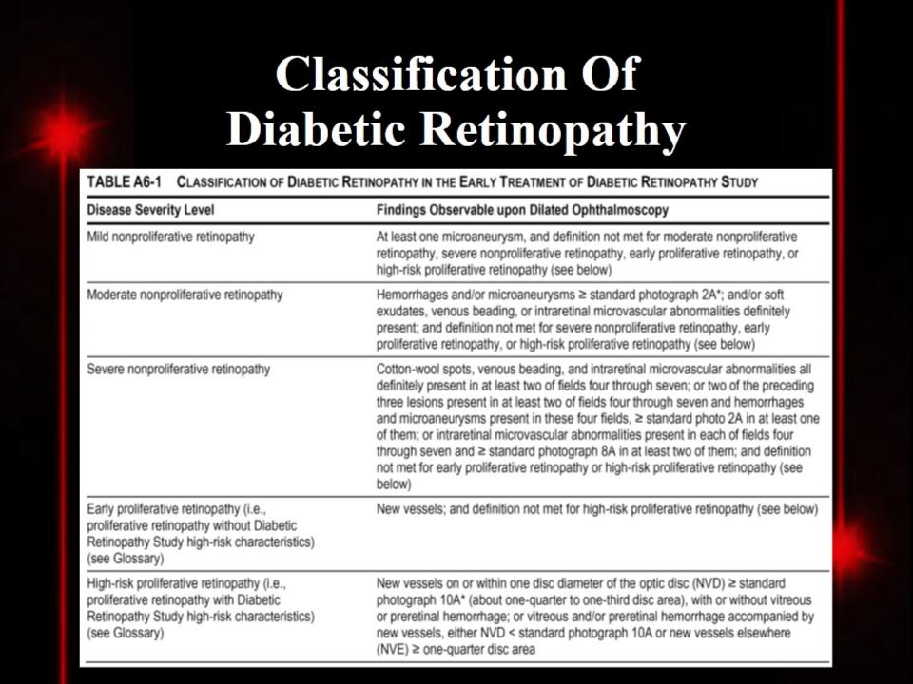
Classification Of
Diabetic Retinopathy

Slide 19
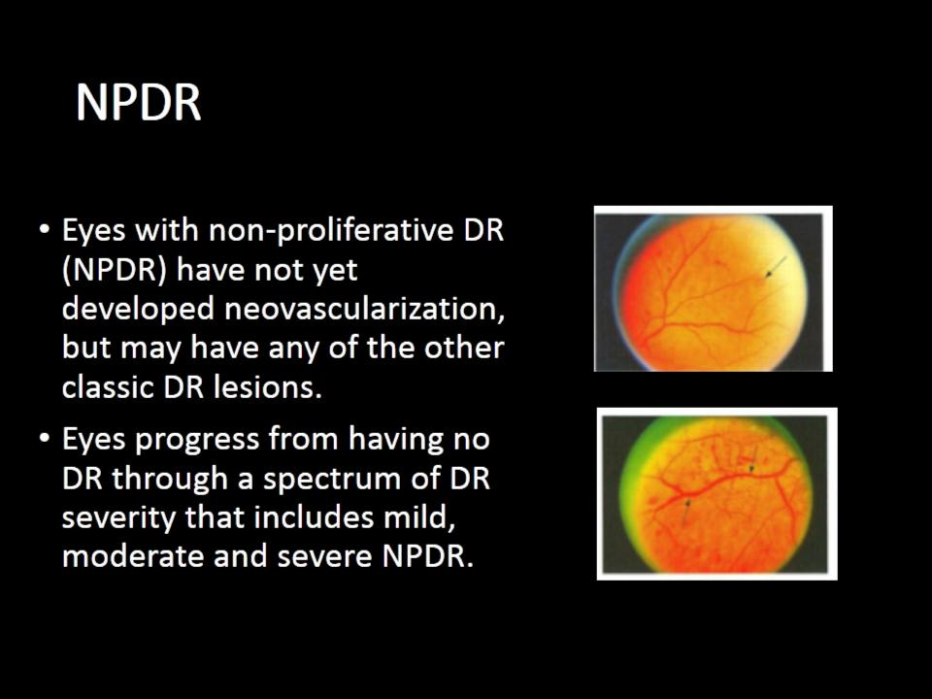
NPDR

Slide 20
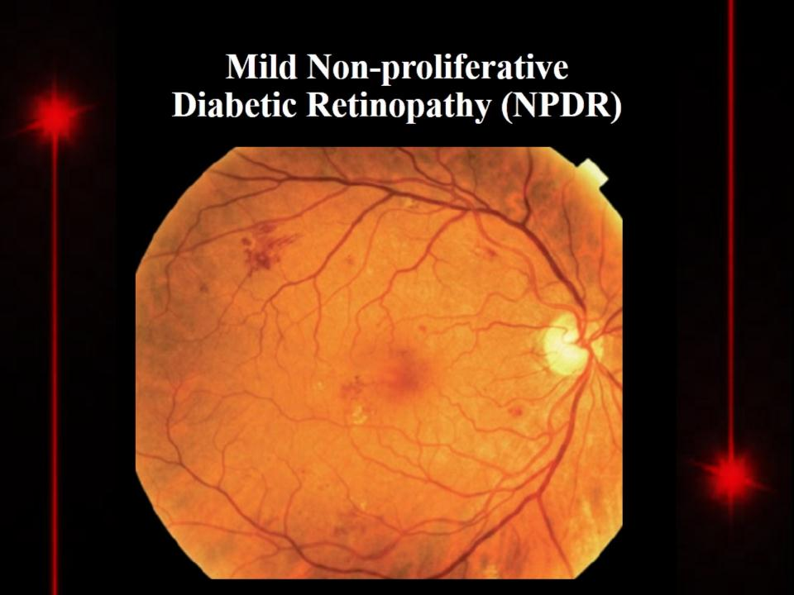
Mild Non-proliferative
Diabetic Retinopathy (NPDR)

Slide 21
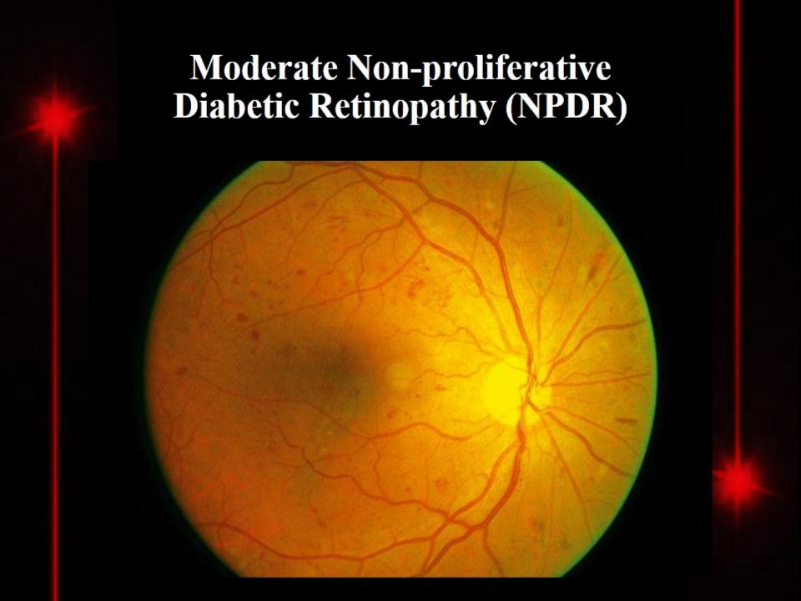
Moderate Non-proliferative
Diabetic Retinopathy (NPDR)

Slide 22
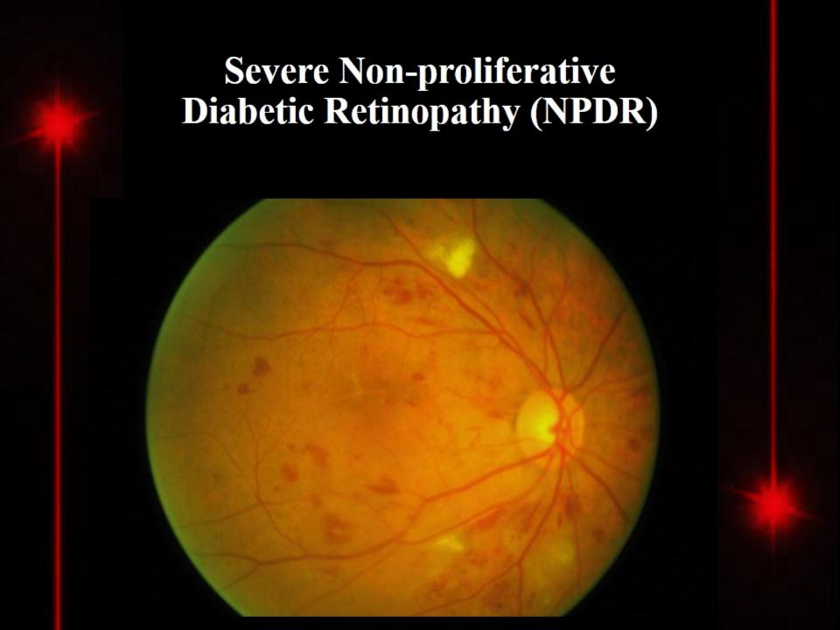
Severe Non-proliferative
Diabetic Retinopathy (NPDR)

Slide 23
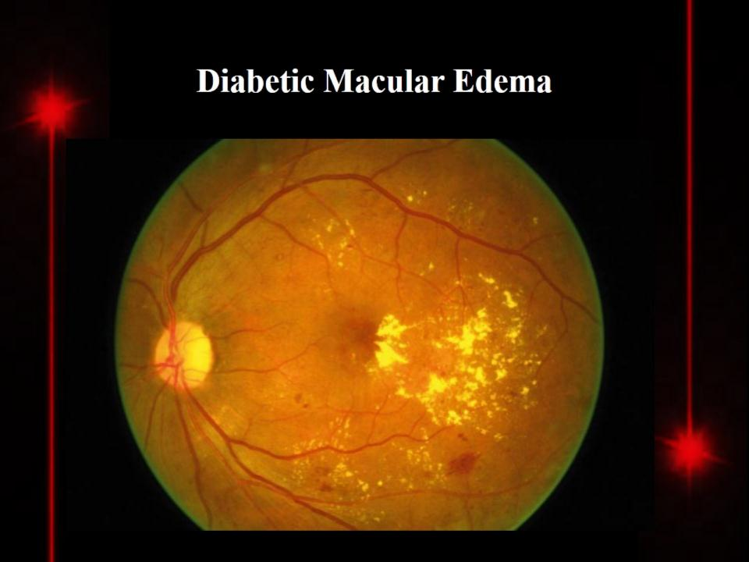
Diabetic Macular Edema

Slide 24
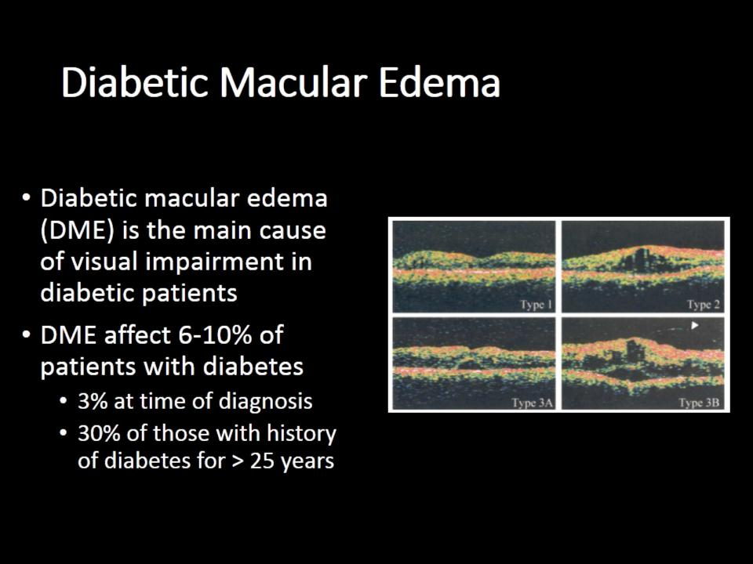
Diabetic Macular Edema

Slide 25
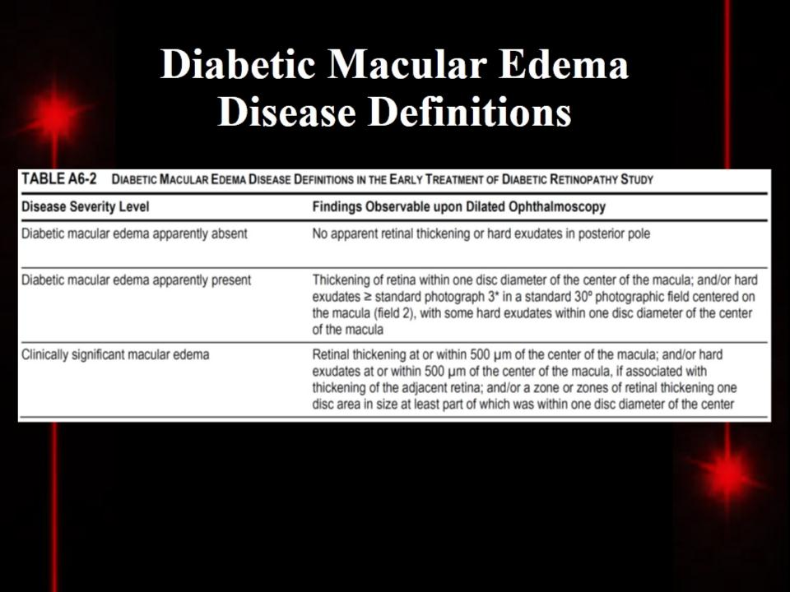
Diabetic Macular Edema
Disease Definitions

Slide 26
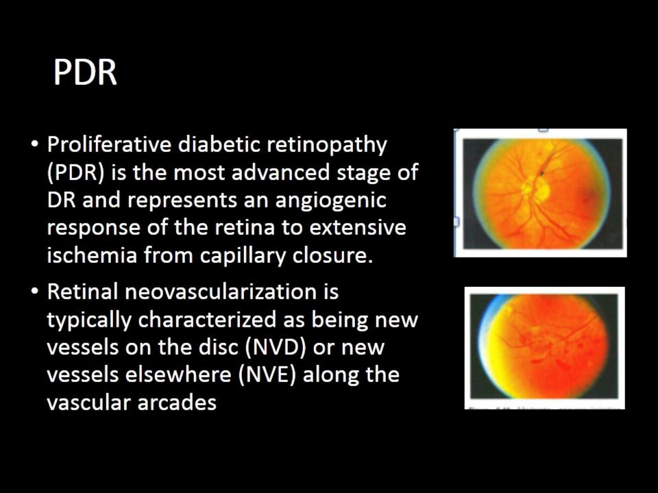
PDR

Slide 27
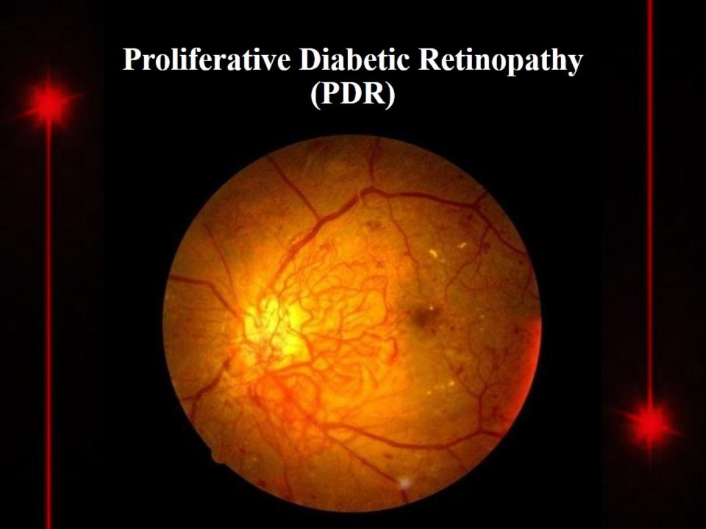
Proliferative Diabetic Retinopathy
(PDR)

Slide 28
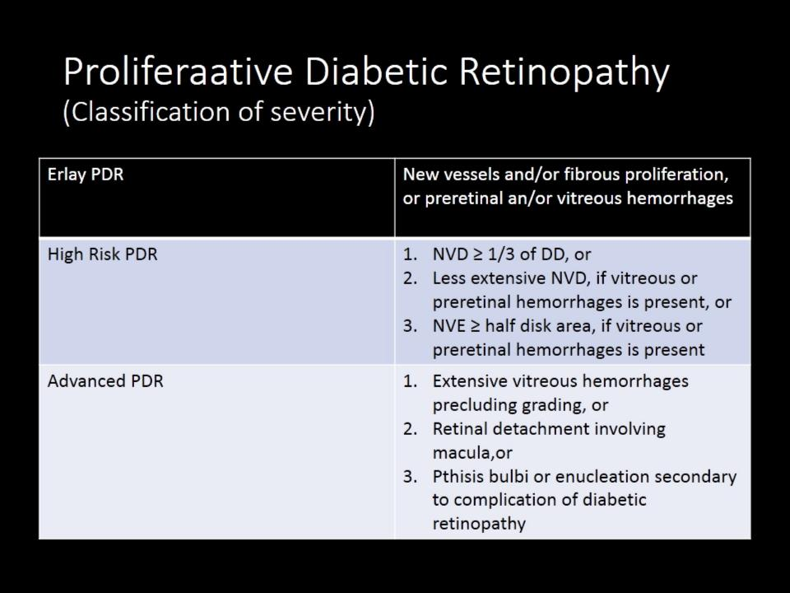
Proliferaative Diabetic Retinopathy
(Classification of severity)

Slide 29
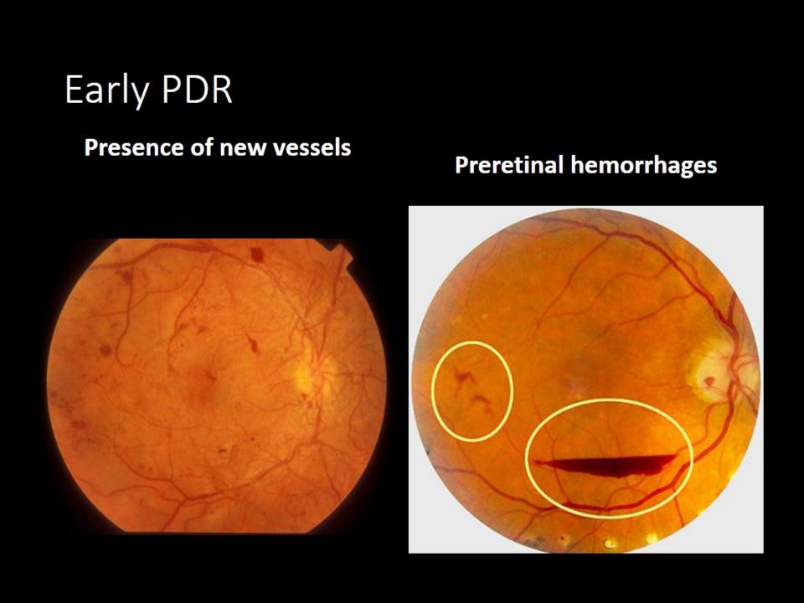
Early PDR

Slide 30
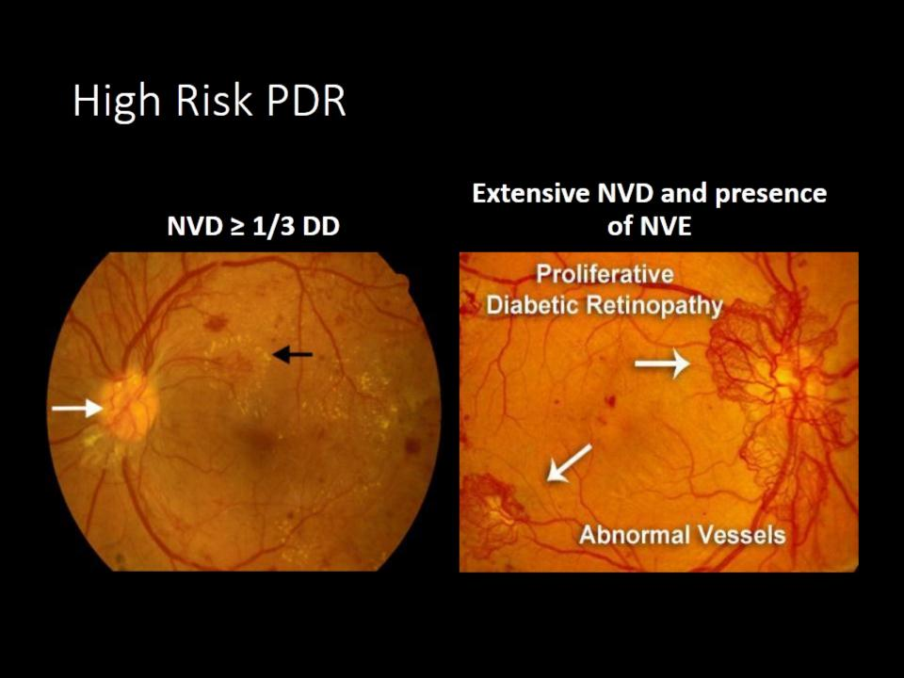
High Risk PDR

Slide 31
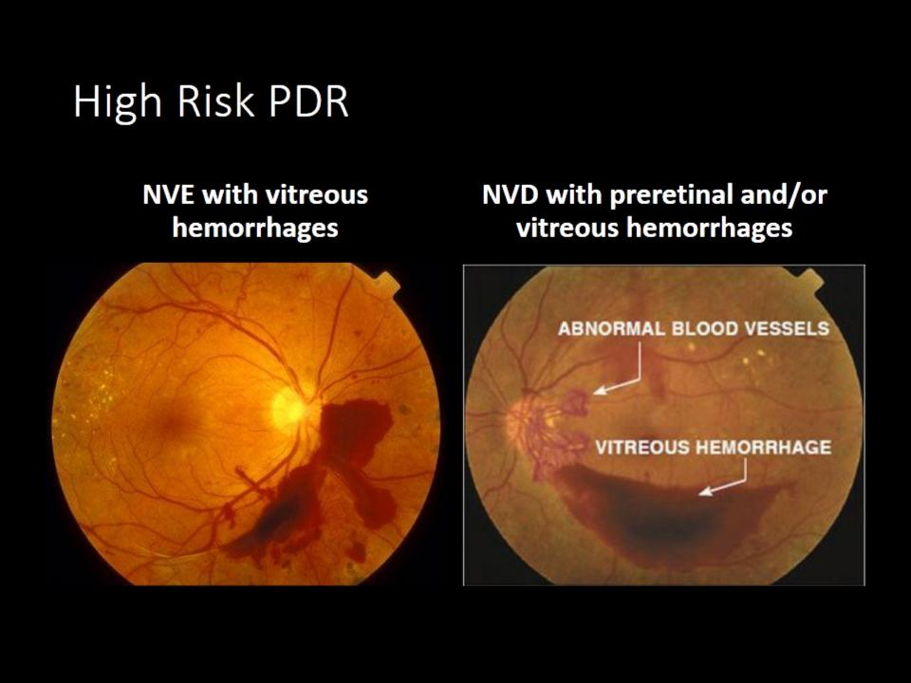
High Risk PDR

Slide 32
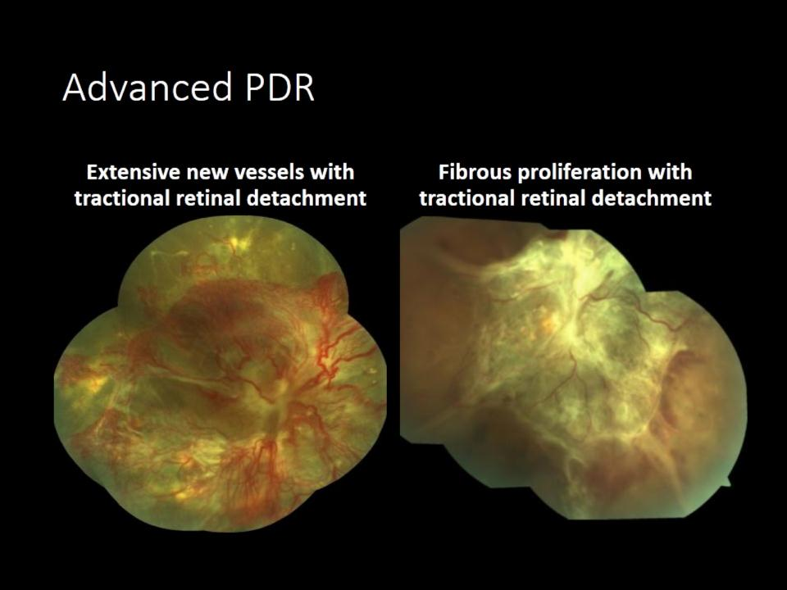
Advanced PDR

Slide 33
Diabetic Retinopathy

Slide 34
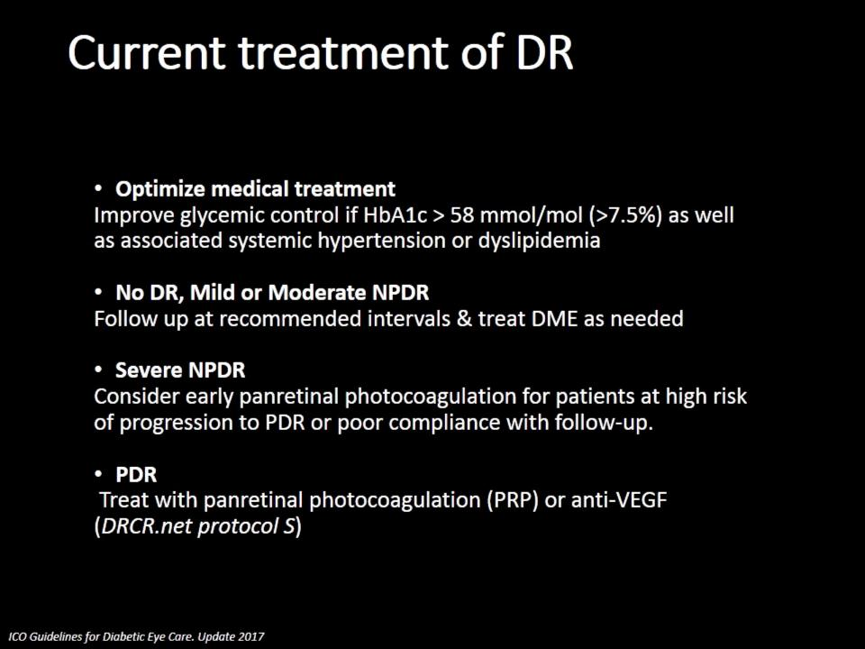
Current treatment of DR

Slide 35
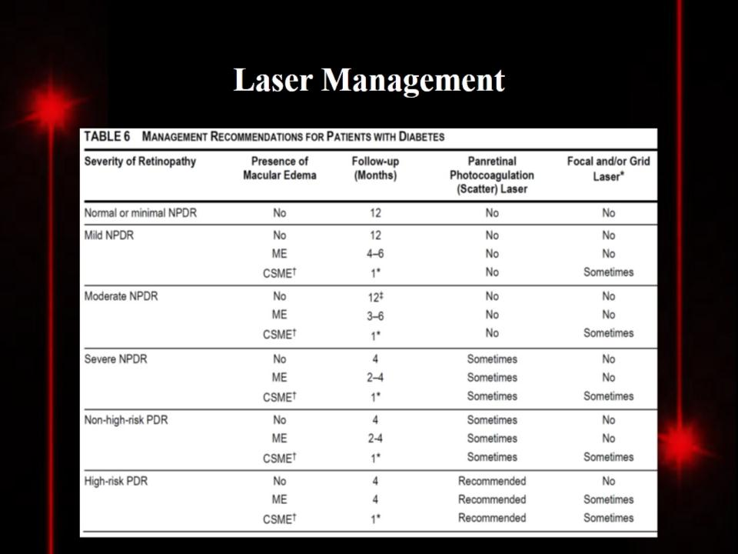
Laser Management

Slide 36
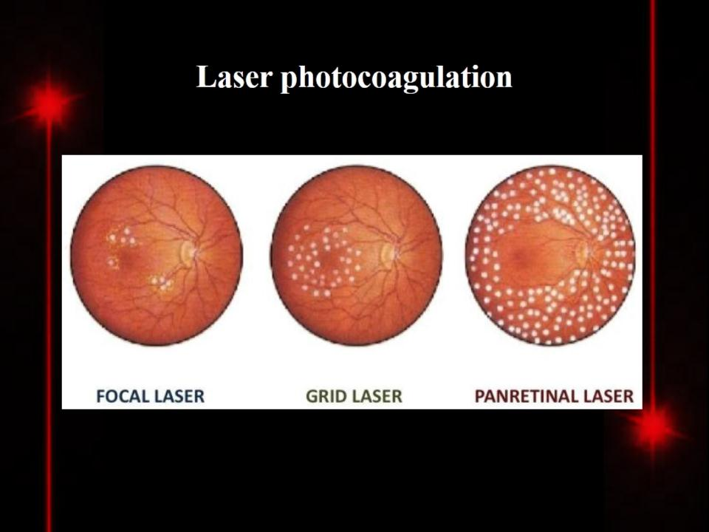
Laser photocoagulation

Slide 37
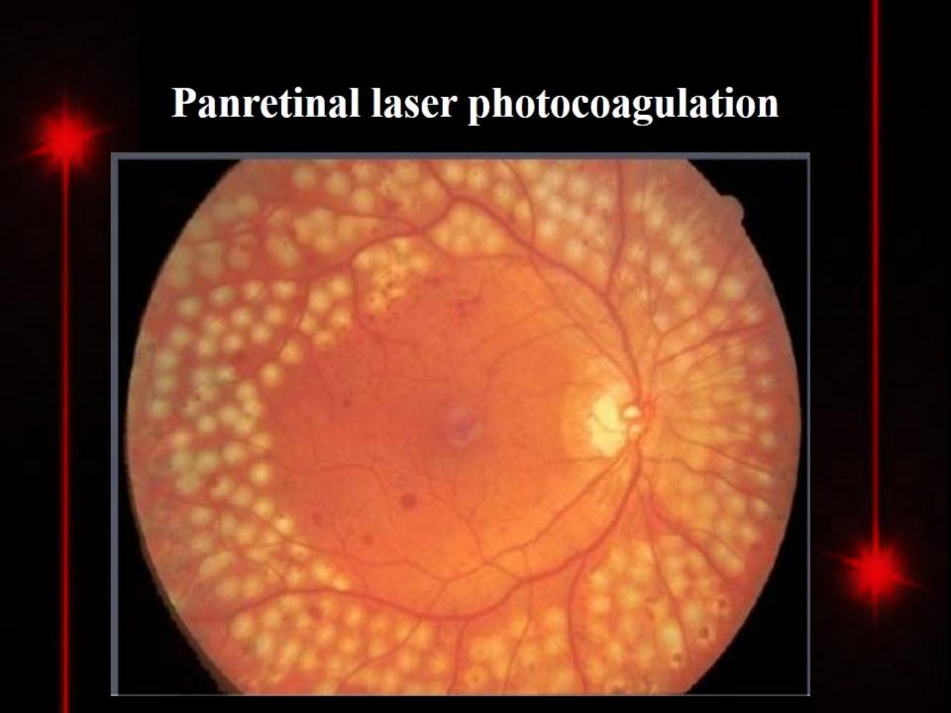
Panretinal laser photocoagulation

Slide 38
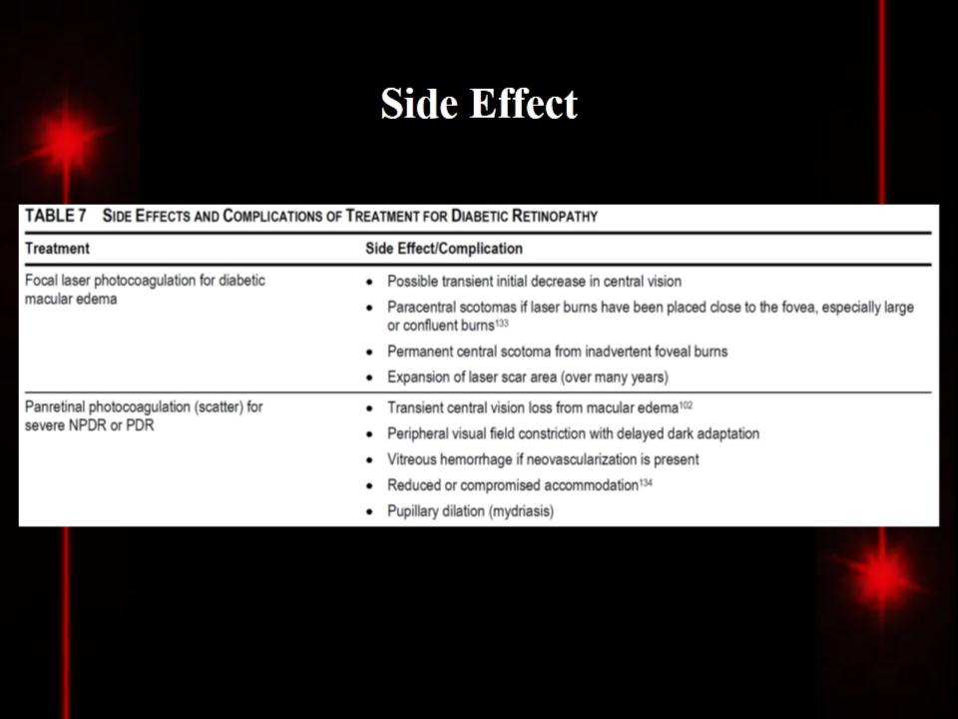
Side Effect

Slide 39


